Slide 1
Chapter 2 Configuration Space
Chapter 3 Rigid-Body Motions
Chapter 4 Forward Kinematics
Chapter 5 Velocity Kinematics and Statics
Chapter 6 Inverse Kinematics
Chapter 7 Kinematics of Closed Chains
Chapter 8 Dynamics of Open Chains
Chapter 9 Trajectory Generation
Chapter 10 Motion Planning
Chapter 11 Robot Control
Chapter 12 Grasping and Manipulation
Chapter 13 Wheeled Mobile Robots
13.1 Types of Wheeled Mobile Robots
13.2 Omnidirectional Wheeled Mobile Robots
13.3 Nonholonomic Wheeled Mobile Robots
13.4 Odometry
13.5 Mobile Manipulation

Slide 2
Important concepts, symbols, and equations

Slide 3
Important concepts, symbols, and equations (cont.)
Mobile manipulator Jacobian J_{e}(𝜃) (not a function of q)
(from odometry)

Slide 4
Important concepts, symbols, and equations (cont.)
Task-space feedforward + PI feedback control
_{e}
_{e}

Slide 5
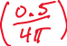




The planar mobile manipulator below has a diff-drive mobile base and a 1R
robot arm. Each wheel radius is 0.5. The positive driving direction for each
wheel moves the robot forward, and positive rotation for the arm joint is about
an axis out of the page. At the configuration below, give the Jacobian J_{e}.

Slide 6
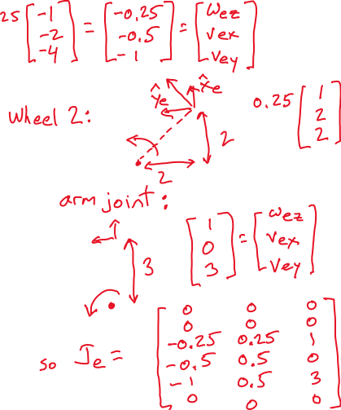
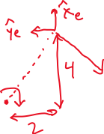

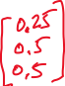

Slide 7
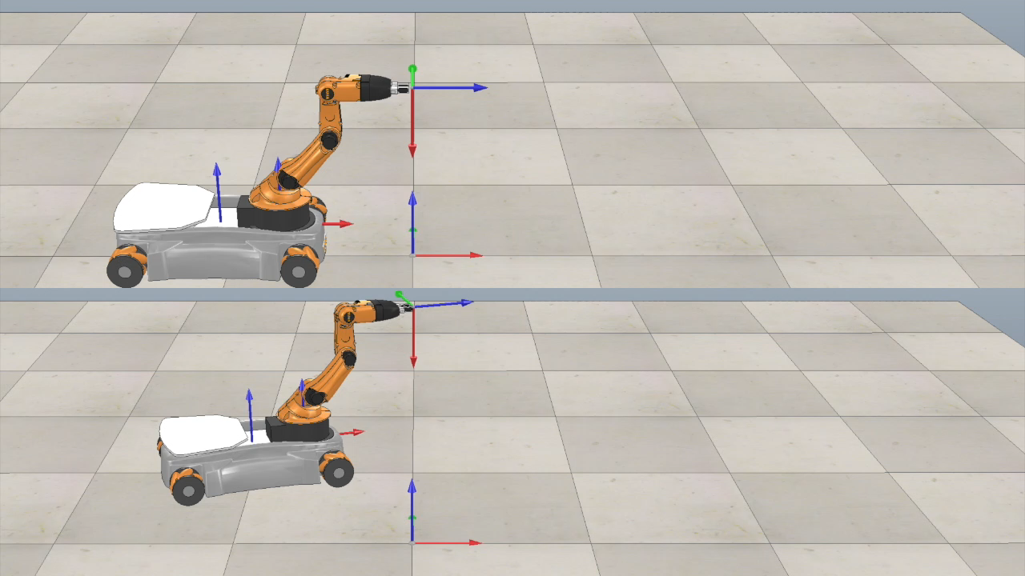
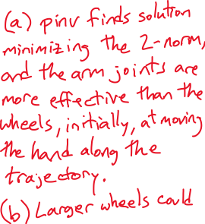

Why does the arm stretch out before the wheels move?
Would anything change if the wheels had a larger radius?

